Slide 1
Singapore Airlines
Group 4

Slide 2
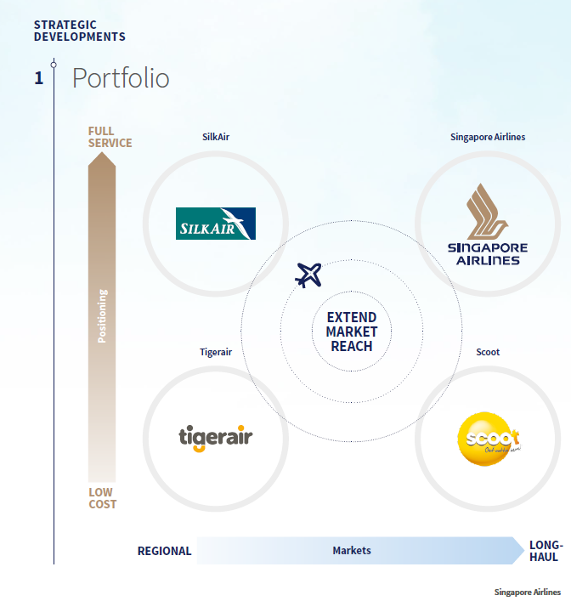
"As the SIA Group moves towards a new phase of growth across all airlines in the Group, our fleet and network continue to expand in support of our portfolio strategy. With both full-service and low-cost airline investments, we remain committed to short-, medium- and long-haul markets with our portfolio of airlines.
The SIA Group continues to place emphasis on the need to adapt nimbly and flexibly to industry changes, so as to stay relevant in the competitive environment as we step up in the next phase of our growth. During the new financial year, Scoot and Tigerair will be merging under the Scoot brand name.
——Quote from SINGAPORE
AIRLINES Annual Report FY2016/17

Slide 3
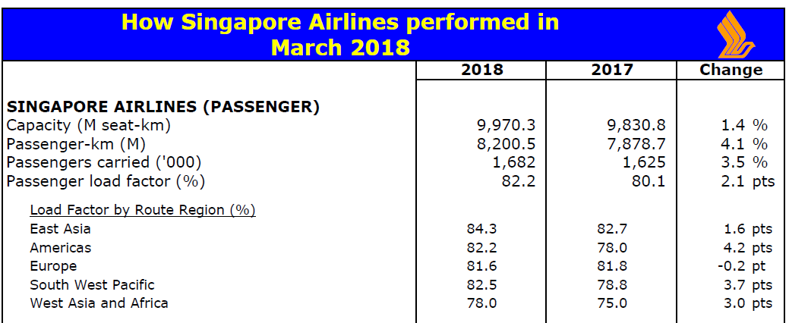
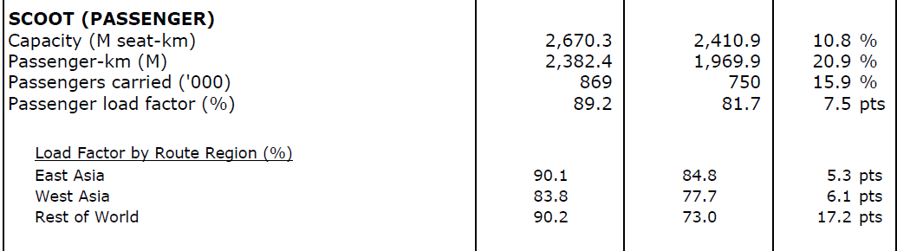
Singapore Airline’s growth is stable. The annual change is around 2~3 %.
Scoot is now fast growing and developing quite quickly.
Due to the price comparative advantage, the load factor is impressively high.
Selected routes to India, South East Asia , China, Australia, and fifth freedom routes to North Asia and America continued to improve.
Source: MARCH 2018 OPERATING RESULTS

Slide 4
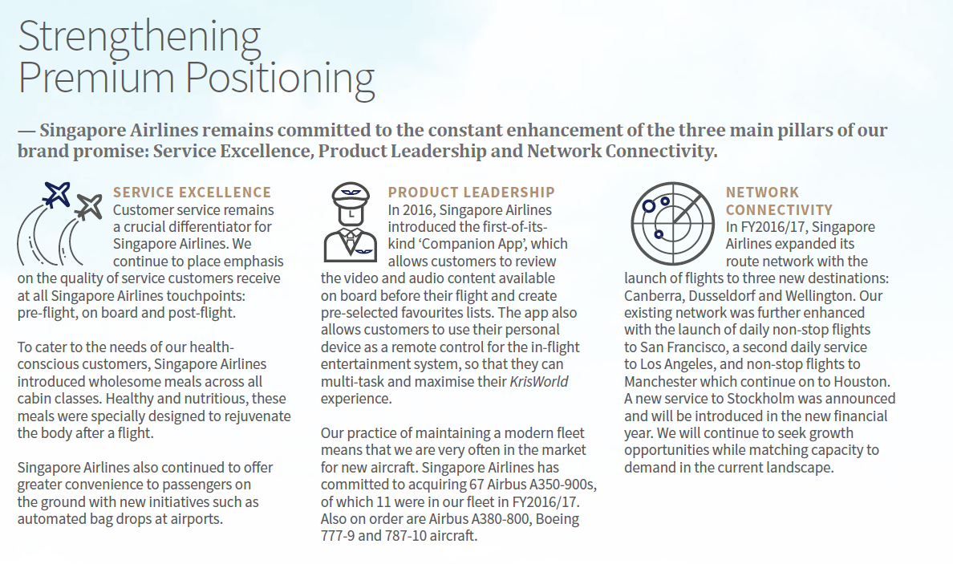

Slide 5

The plan of expansion of Tigerair

Slide 6
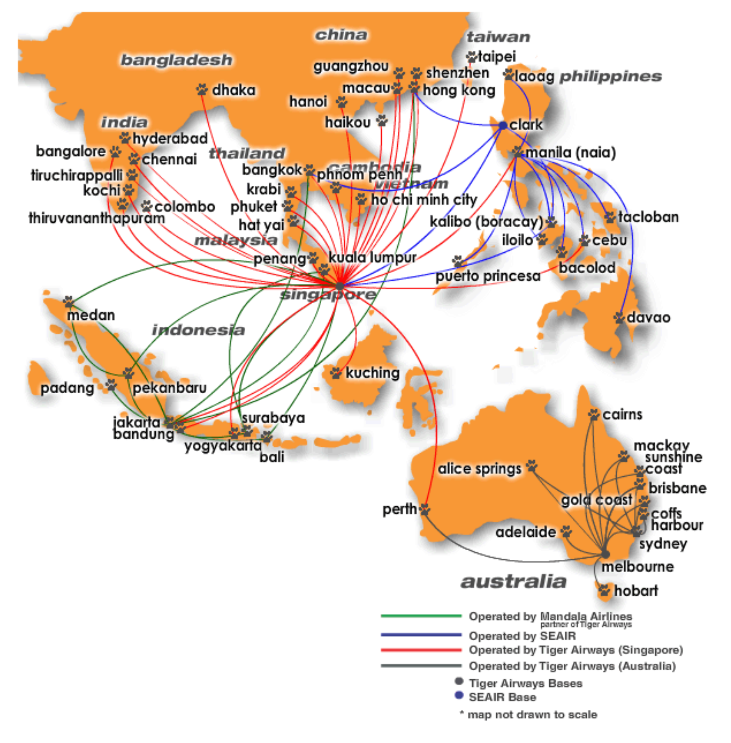
1. General description of Tigerair
In 2015-2016 year:
5128000 travelers took tigerair, which takes 18.89% in SIA group;
40 destinations in 12 asian-pacific countries;
23 aircrafts;
In 2016-2017 year:
5145835 travelers choose tigerair, which takes 13% among SIA group.
23 Aircrafts;
12 cities in china;

Slide 7
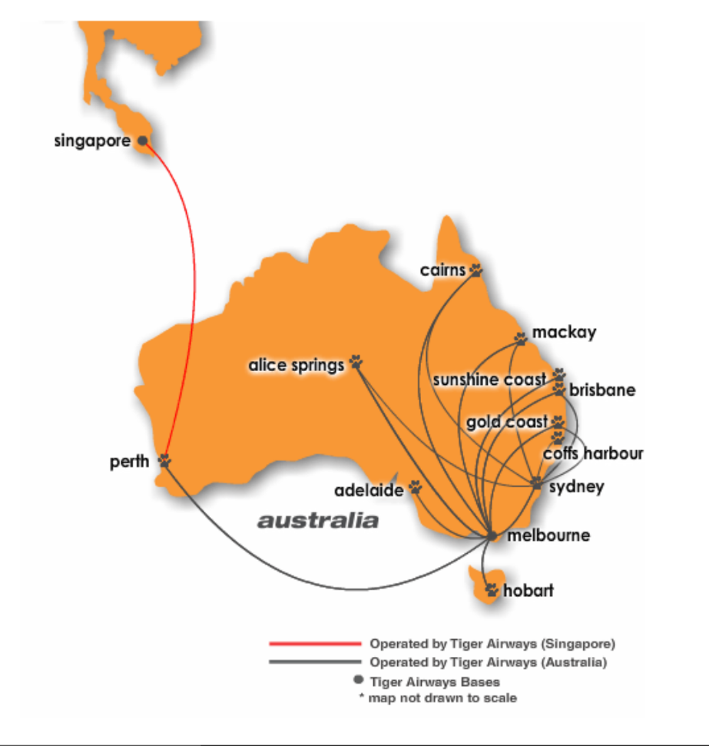
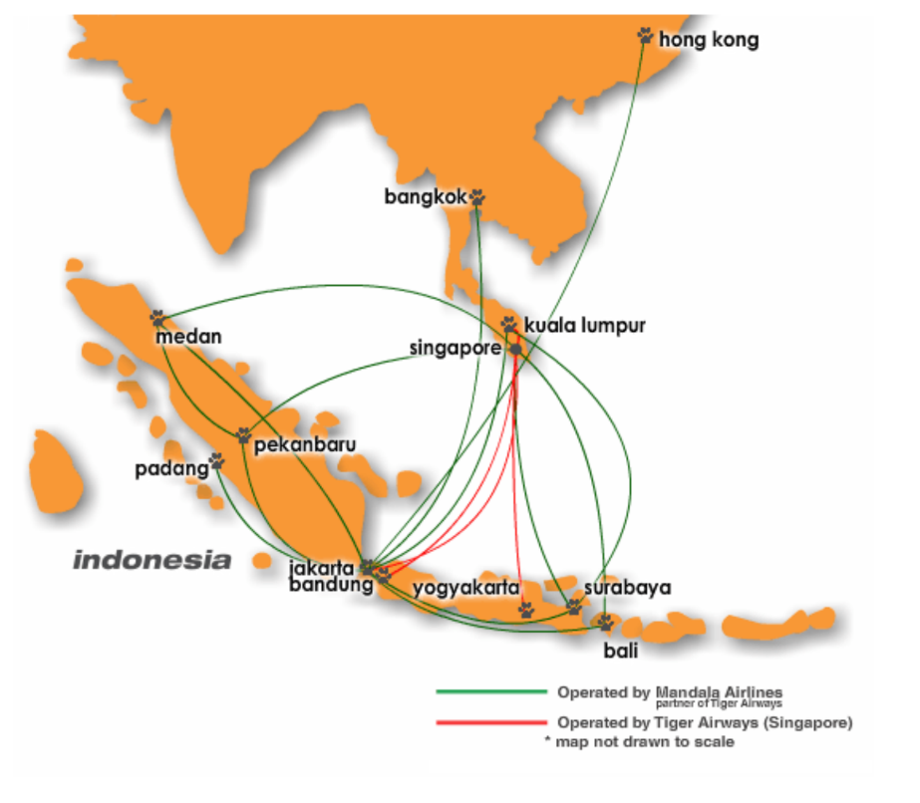
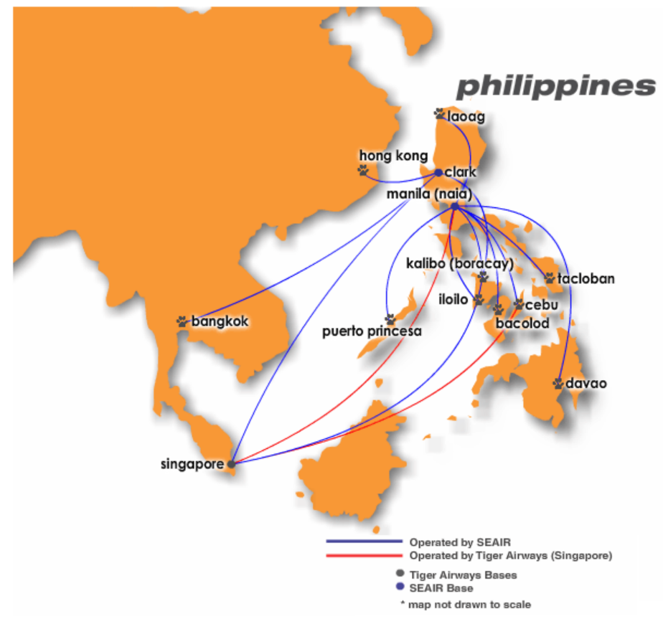

Slide 8
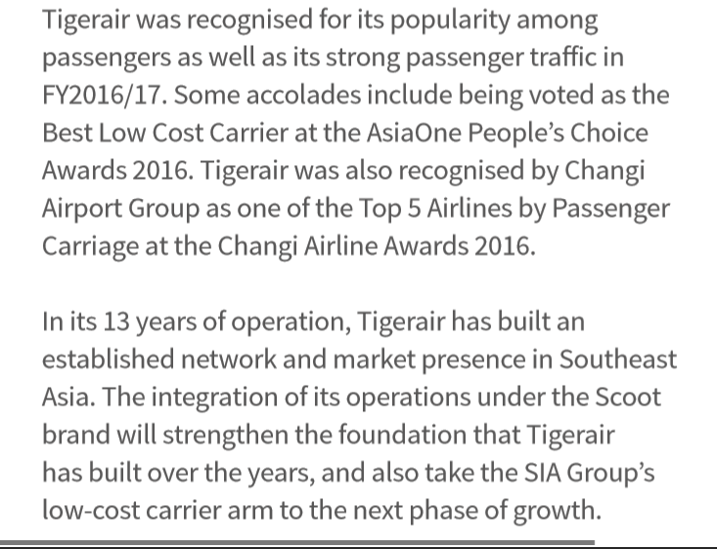
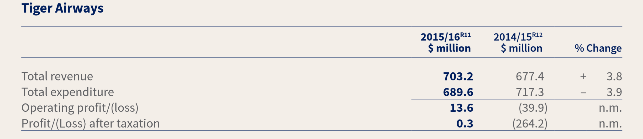
Load factor increased to 83.3% by 1.2%;
More destination from china, India and Malaysia.

Slide 9
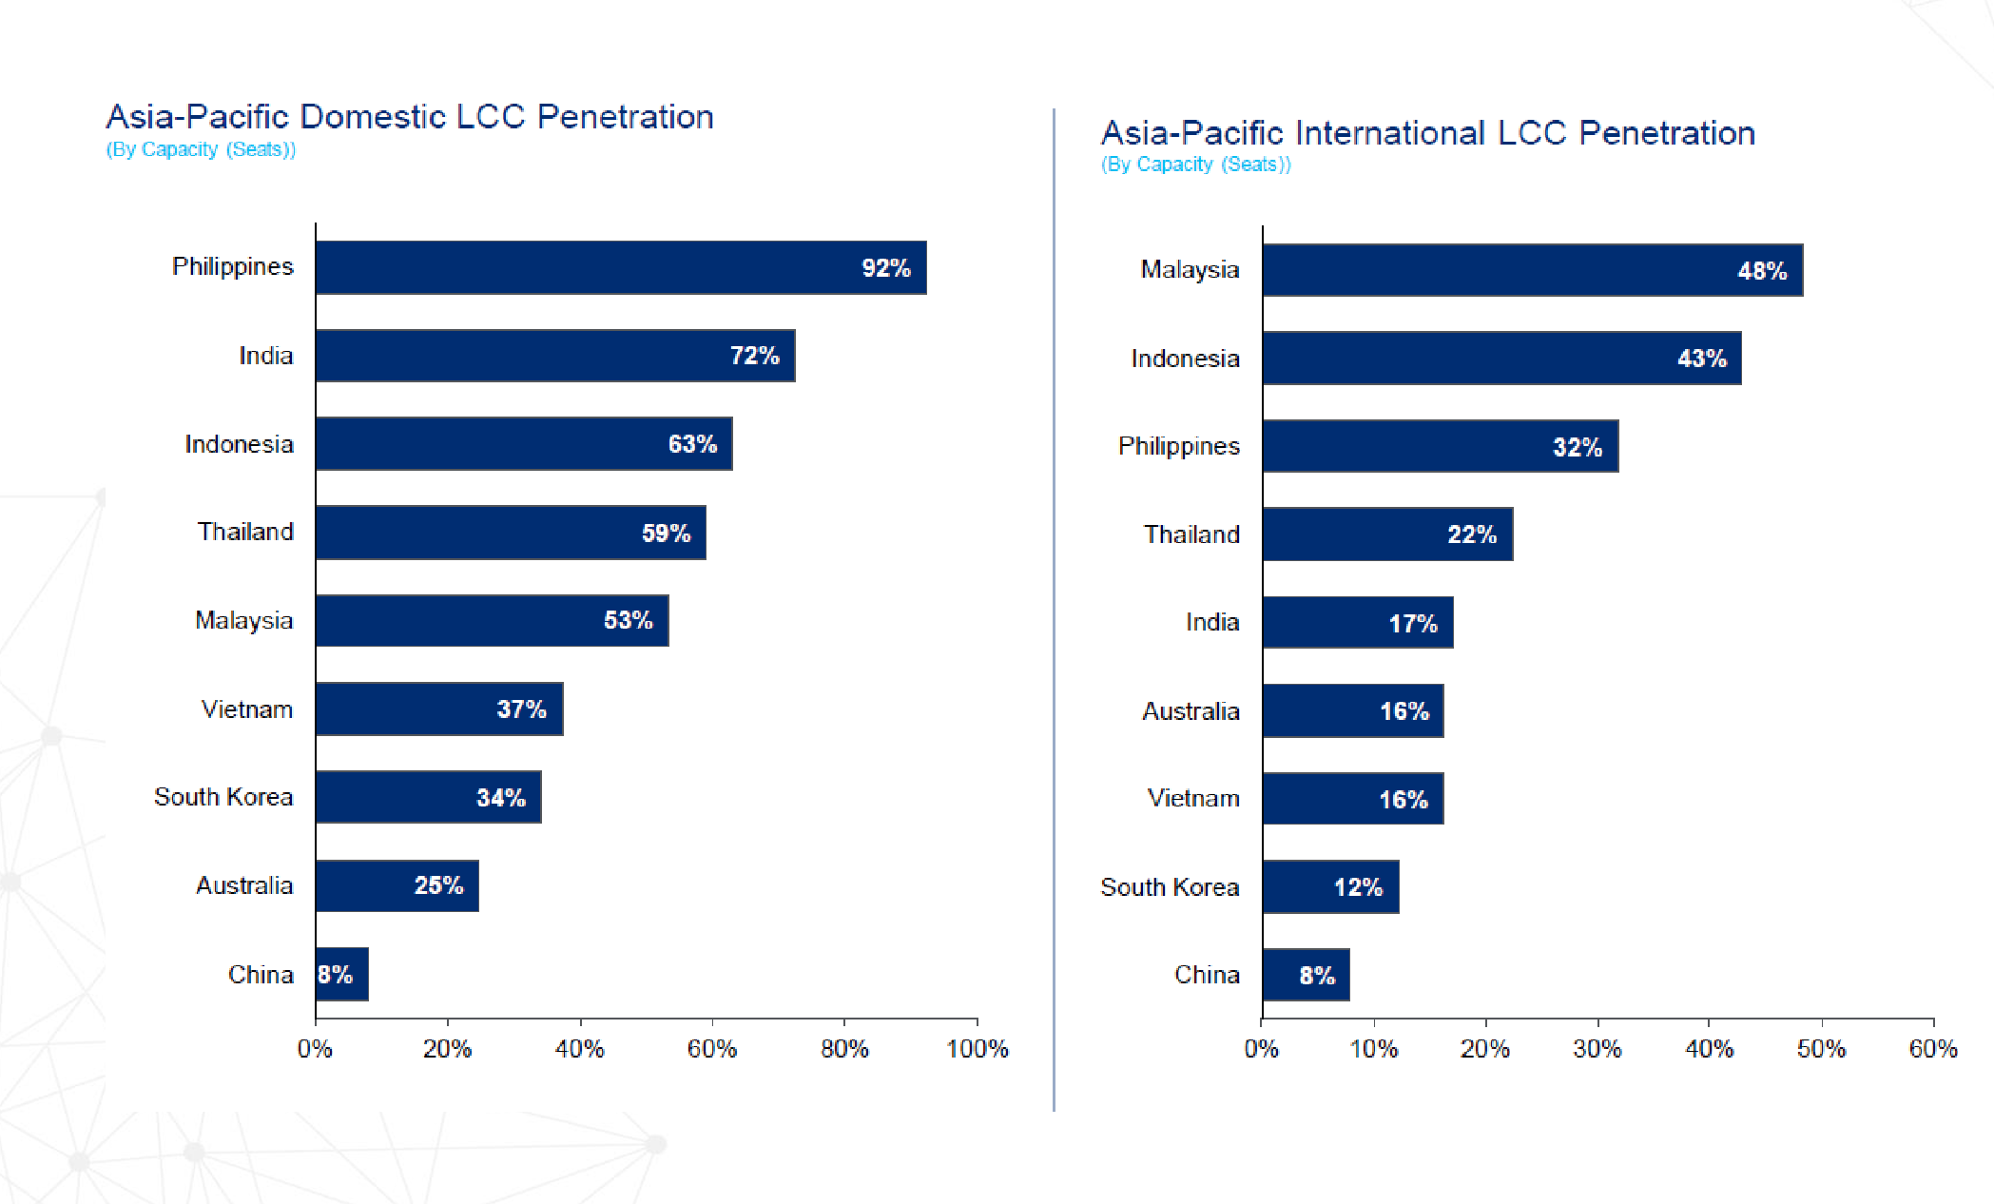
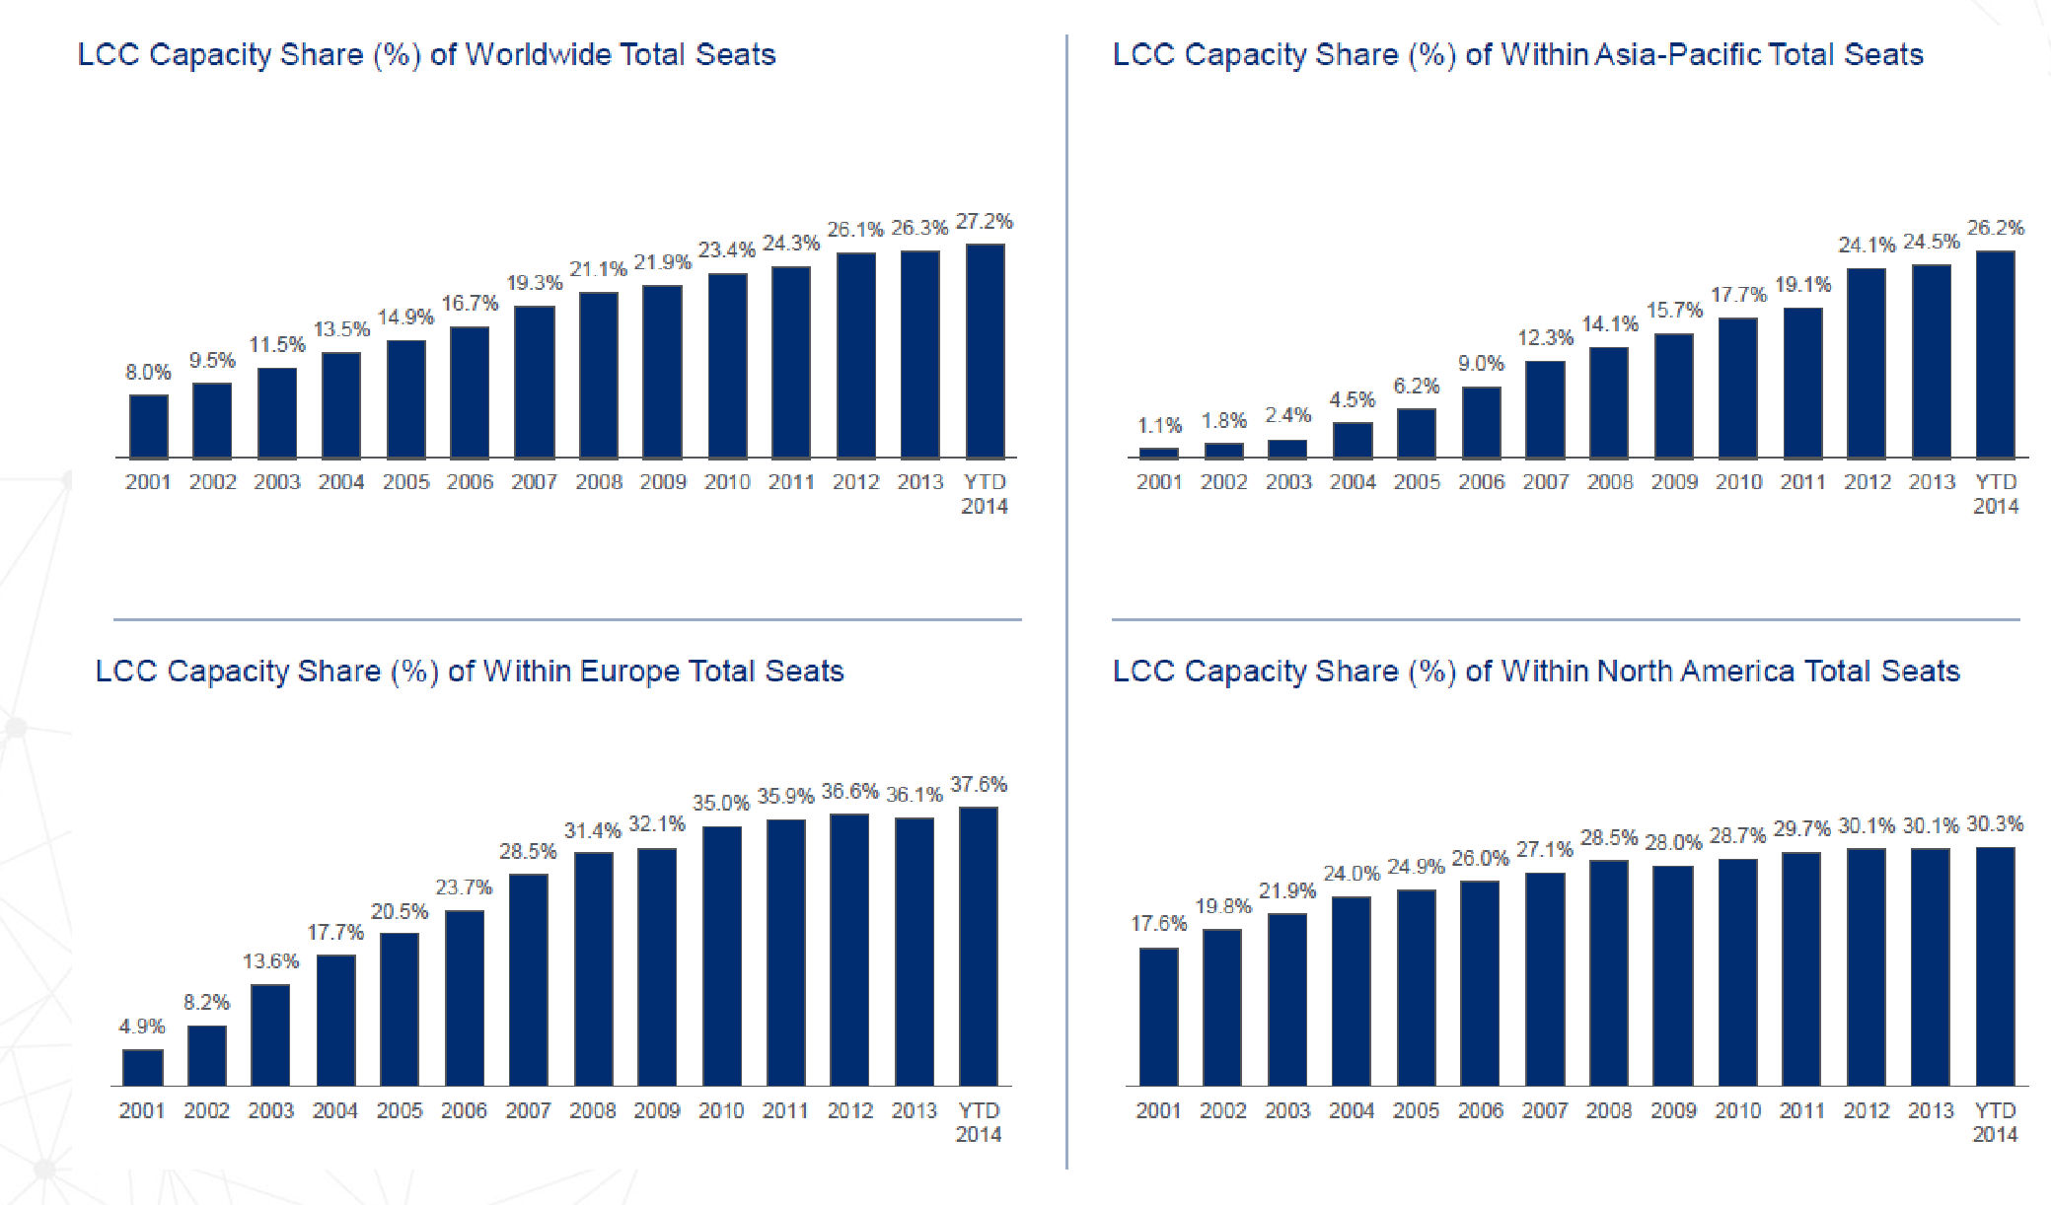
2. The LCC market in Asia-Pacific Tigerair

Slide 10
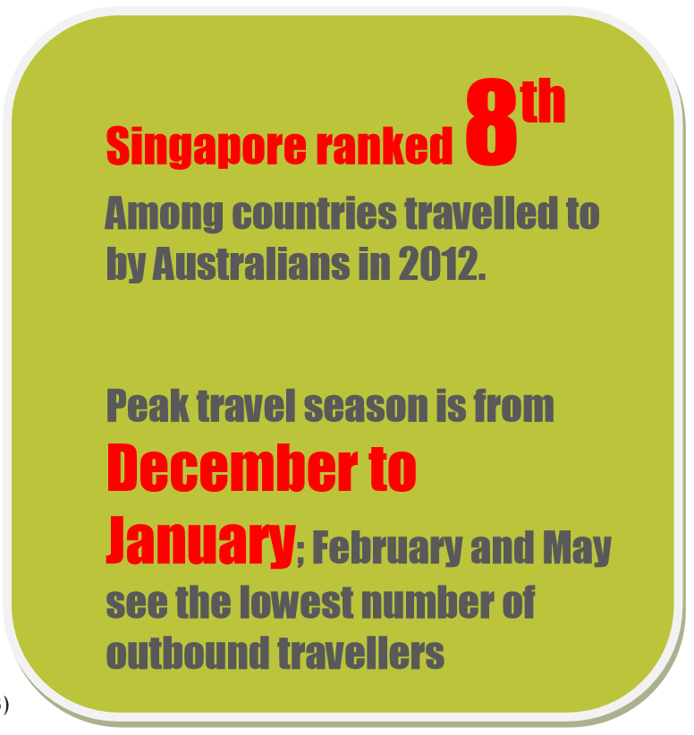
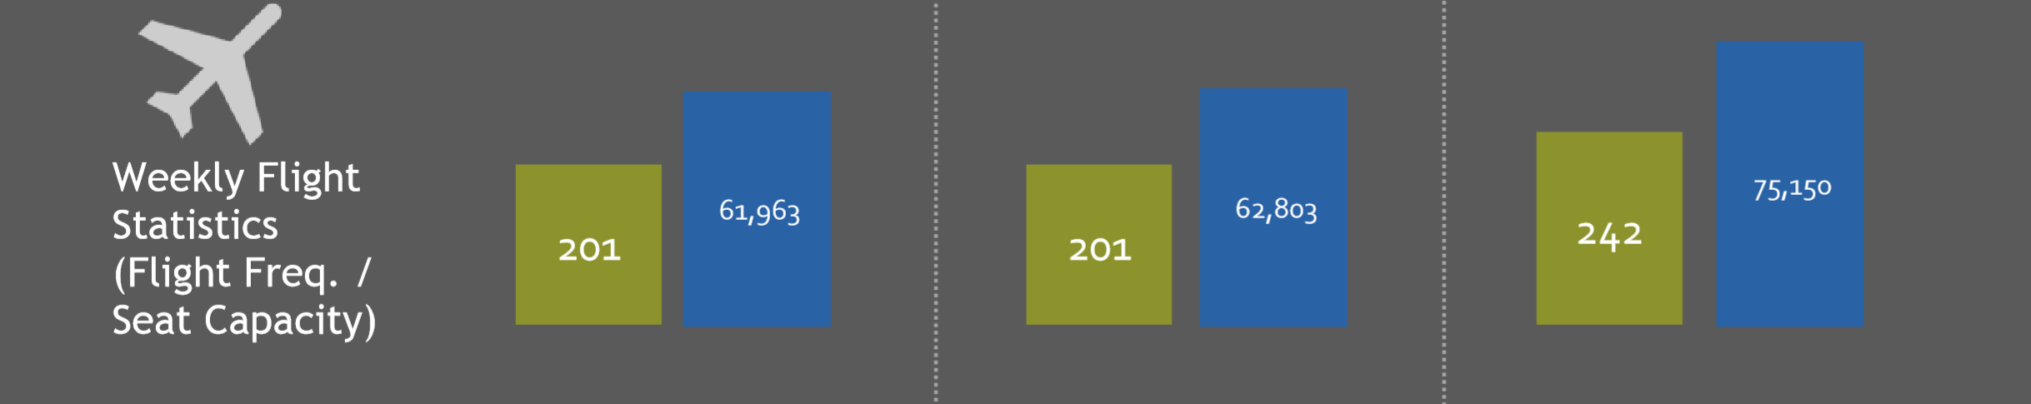
3. Investment on flights between Australia and Singapore
2014 2015 2016

Slide 11
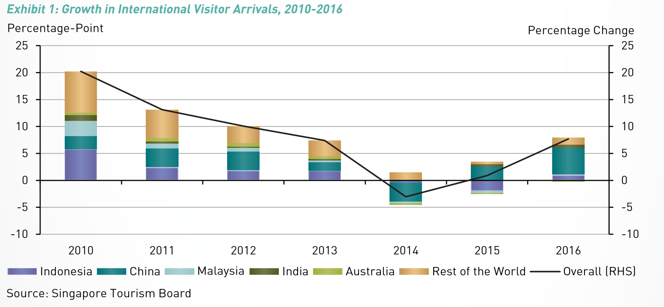
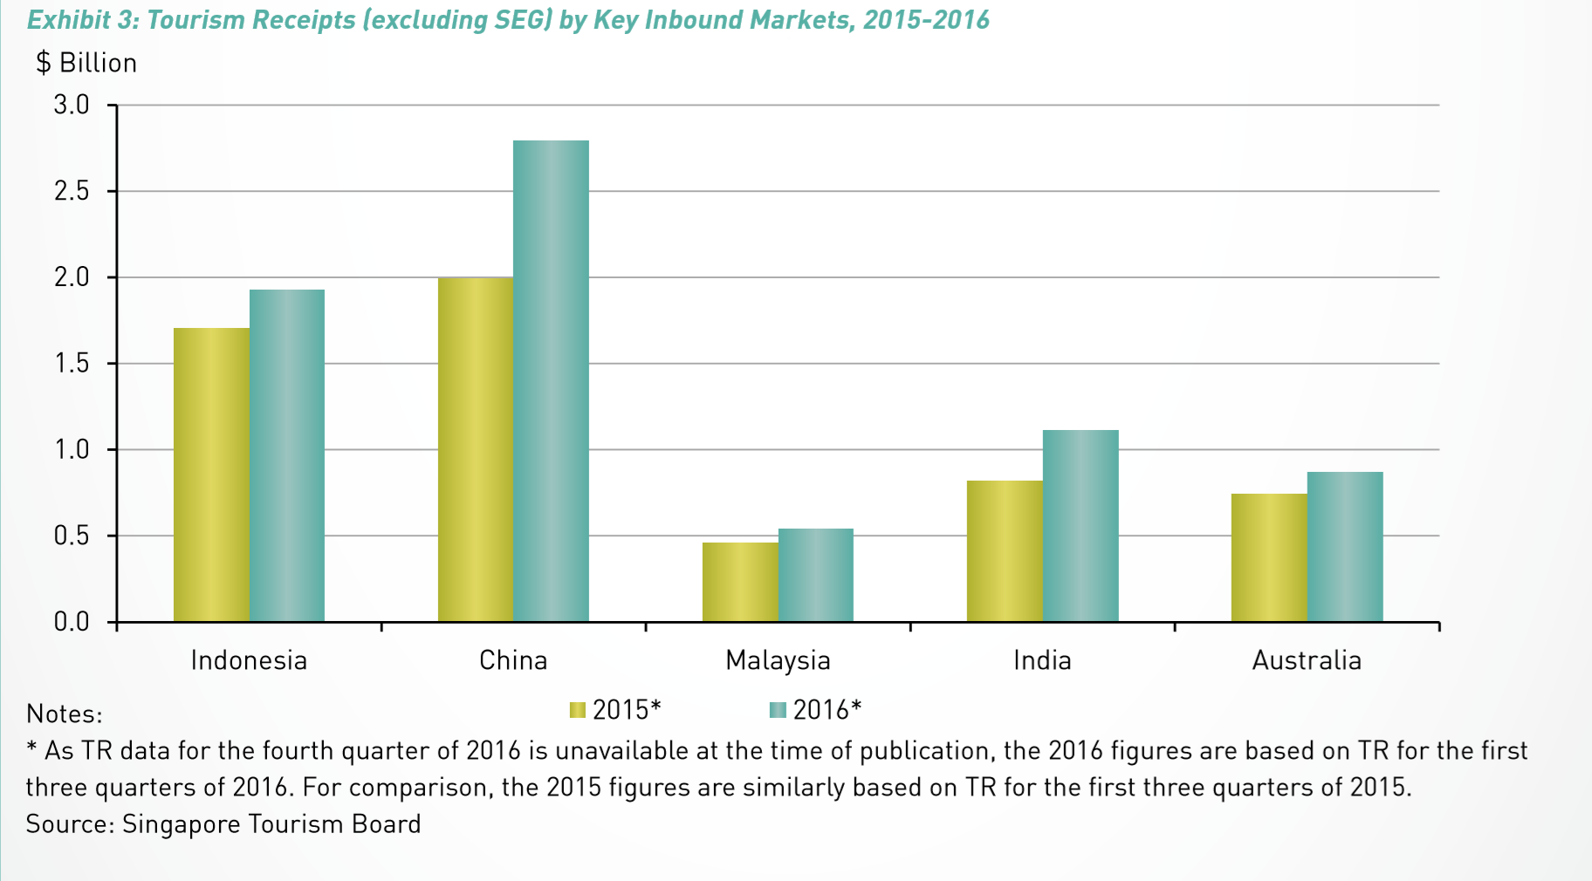
3. Investment on flights between China and Singapore

Slide 12
4. SWOT of the proposal
Strength
several sub-groups
Weakness
Aircrafts not enough;
Without flight permission;
Opportunities
More profits for Tigerair;
More connection between sub-groups;
more passengers for SIA
Threats
Some other competitors, like Qantas;
Competition from SIA.

Slide 13

Scoot - Tigerair Merger

Slide 14
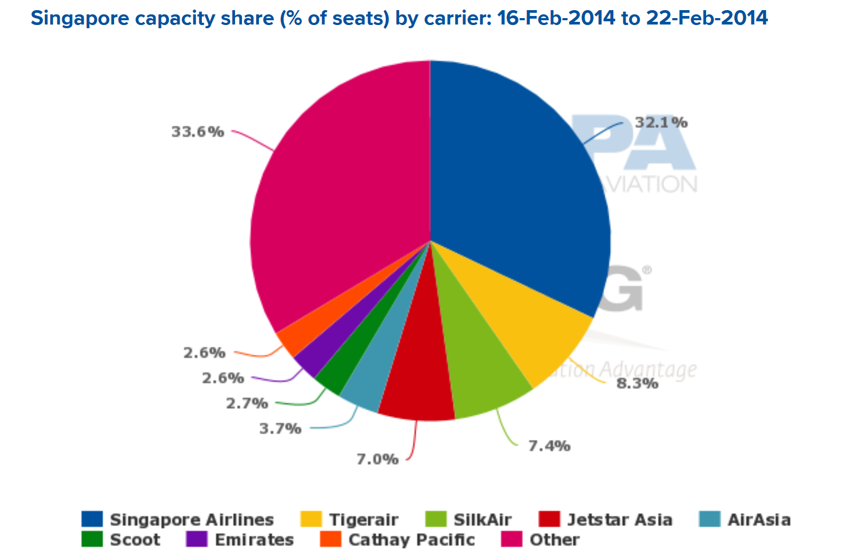

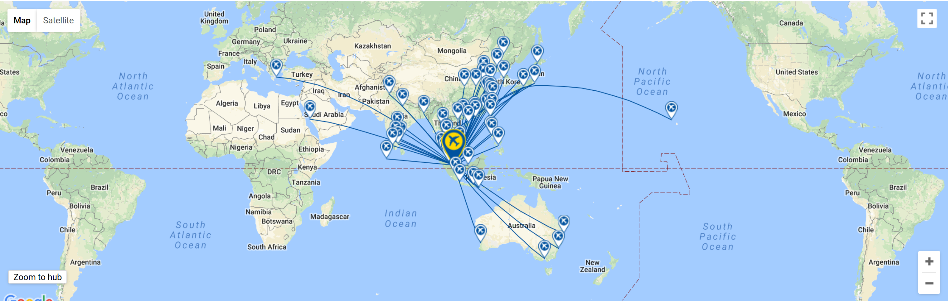
Who is Scoot
Singapore Airlines Group Low Cost Carrier (LCC)
Begun Operations: 2012
Main Hub: Singapore Changi Airport
Alliance: Value Alliance

Slide 15
Causes and Consequences
Conflict
Tigerair
Scoot
Tigerair is better filling its seats with local passengers, does not need large groups
Tigerair implements a point to point strategy
A lot of overlapping activities → cost reduction if merged
Scoot implements a network strategy
Consequences: Both airlines to have common commercial objective & reduce cost by eliminating overlapping functions.

Slide 16
SWOT for Scoot & Tigerair Merge
Strengths
Both recognizable brand names
Many hubs combined
Significant number of routes serviced in Asia
Large combined fleet
Sizeable player in the LCC market in Singapore
Weaknesses
High competition from other LCC
Limited market share
Threats
Pilot shortage!
Increased fuel cost
Increased specialized labour cost
Regulation e.g. Tigerair AUS flights grounded (For safety concers. Shame! Might drag Scoot down with it)
Opportunities
Expanding to more popular destinations
Rise of Asian tourism industry
Increased GDP in Asian Countries
Internet allows reaching new customers at minimal costs

Slide 17

The Competition
Low - Cost
Full Service
Air Asia
Jetstar
Singapore Airlines
Silkair
Full Service airlines are a different market
Scoot (2012)+Tigerair (2003) vs. Air Asia (1996)
Fleet
43 against 92 medium to large aircraft
Revenues 2016
USD 990M against USD 1.12B

Slide 18
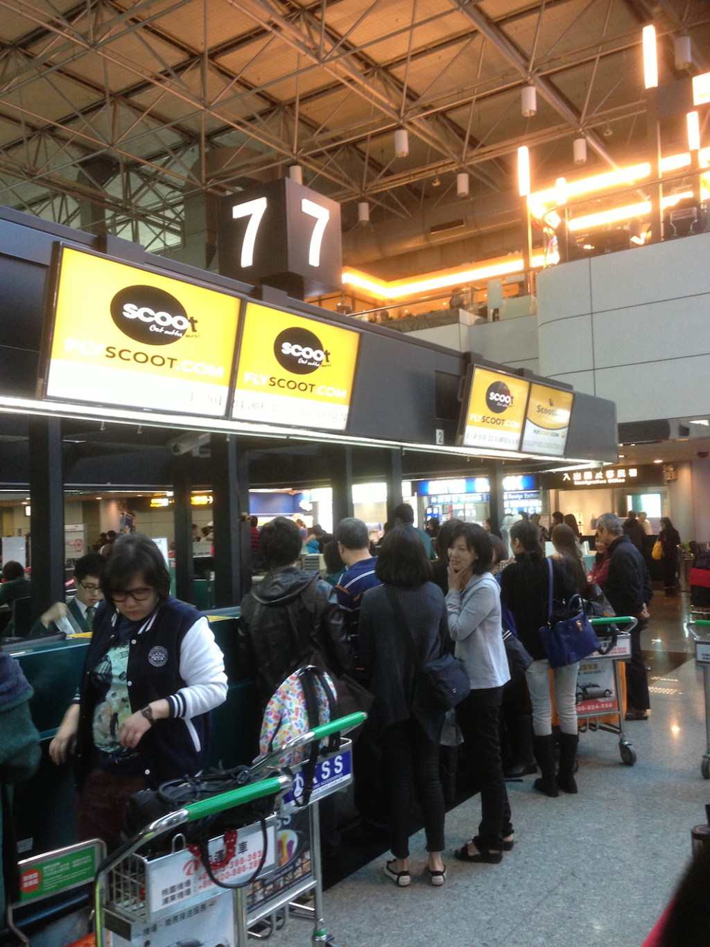
Merging Issues
Takeover and Branding: Scoot, Tigerair or Scoot/Tigerair?
Overcapacity
Tigerair’s A320s have a high lease cost
Tigerair’s order book is ambitious
Long haul routes are a risky and expensive business
Apparently they went with Scoot!

Slide 19
Conclusion
Tigerair
Scoot
Joint management team
The mode of joint operation can occupy more market share and be competitive in the fierce LCCs market in Southeast Asia.
the new structure will allow the two airlines to integrate and share functions such as sales, marketing, IT, planning and operations.
Asia, short route
21 A320, 2 A319
41 Destinations
5.1 M Pax(2016)
Australia, Europe, U.S, long route
14 B787
23 Destinations
3.3 M Pax(2016)
The current transfer traffic volumes are insufficient, given Scoot’s network model and commitment to rapid expansion.
If Scoot is planning to expand capacity (ASKs), much bigger operation that may only be viable with more feed from Tigerair.

